Slide 1






WORLD HAPPINESS INDEX
PROJECT PRESENTATION - 2

Slide 2

objective
We are performing regression analysis on the World Happiness Index 2017 dataset to identify the key factors affecting happiness scores, and verify the model assumptions using diagnostic tests.

Slide 3
COUNTRIES
HAPPINESS SCORE
ECONOMY
FAMILY
Measure of subjective well-being
GDP Per Capita
Measure of perceived social support
LIFE EXPECTANCY
FREEDOM
GENEROSITY
TRUST
Average number of years a person is expected to live
Extent of individual's freedom to make life choices
Extent to which individuals are observed to be caring, donating, and volunteering for others.
Perceived absence of corruption in government

Slide 4
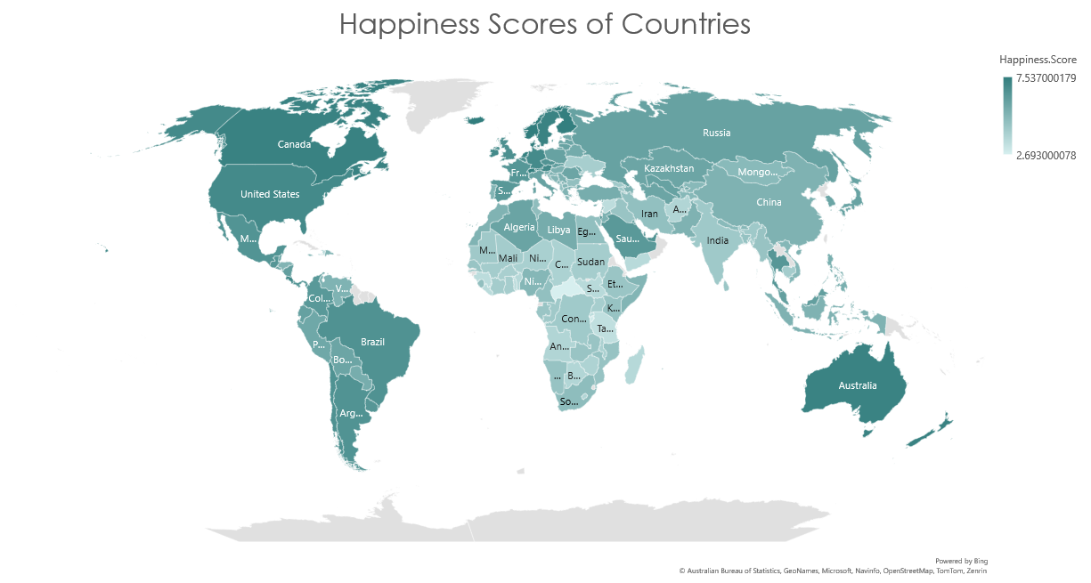

Slide 5

MULTIPLE LINEAR REGRESSSION
Multiple linear regression is a statistical method that models the linear relationship between one dependent variable and two or more independent variables.
The independent variables in our analysis are Economy, Life Expectancy, Family, Freedom, Generosity, and Trust.
The dependent variable is the Happiness score.

Slide 6




MULTIPLE LINEAR REGRESSSION
Multiple linear regression is a statistical method that models the linear relationship between one dependent variable and two or more independent variables.
The independent variables in our analysis are Economy, Life Expectancy, Family, Freedom, Generosity, and Trust.
The dependent variable is the Happiness score.

Slide 7


HAPPINESS SCORE VS ECONOMY
LINEAR REGRESSION MODEL

Slide 8

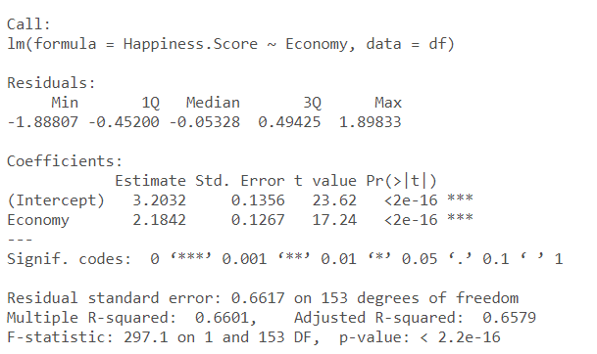
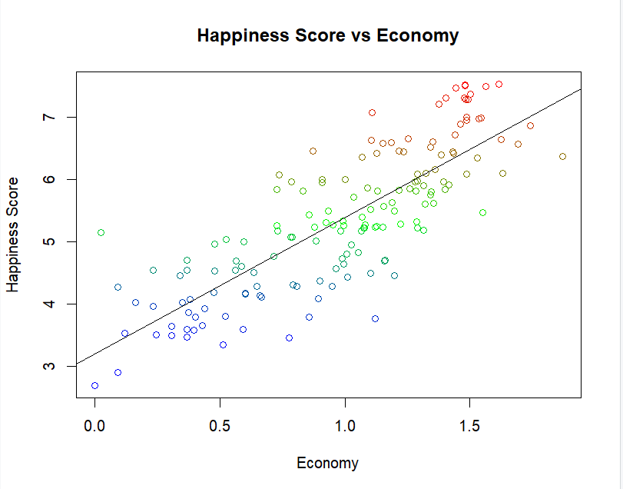
The model estimates that the expected score when Economy is zero, is 3.2032.
The coefficient of Economy is estimated to be 2.1842, with a standard error of 0.1267. The coefficient is also significant which suggests that Economy is a significant predictor of Happiness Score.
The model's goodness of fit is assessed by the R-squared value, which is 0.6601. The adjusted R-squared, which accounts for the number of predictors in the model, is 0.6579.
The F-statistic is 297.1, with a very small p-value which suggests that the model is statistically significant and can explain a significant proportion of the variance in Happiness Score.
The residuals have a mean of 0 and a standard deviation of 0.6617, which suggests that the model has adequately captured the relationship between Happiness Score and Economy.

Slide 9
HAPPINESS SCORE VS…
MULTIPLE LINEAR REGRESSION MODEL

Slide 10
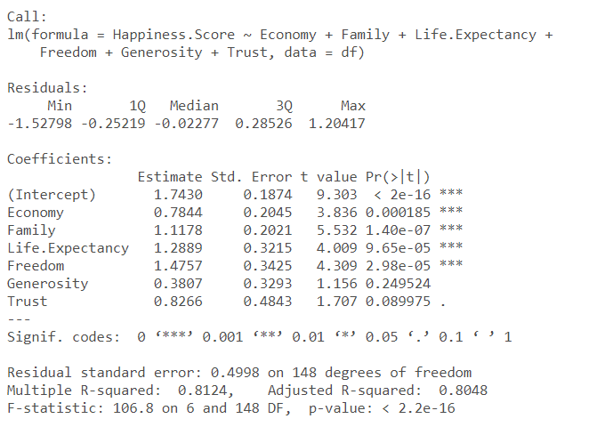
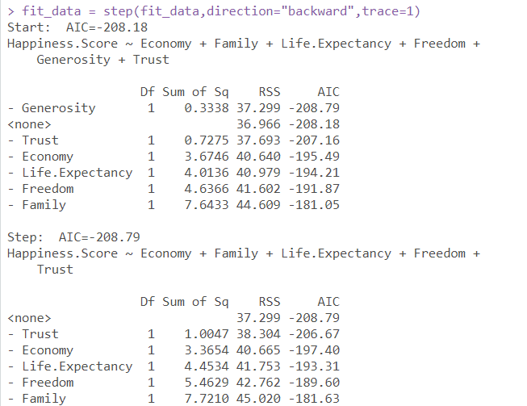
The median value is centered around zero indicating that the residuals are somewhat symmetrical. The minimum and maximum residuals in this case are - 1.20417 and 1.52798, respectively, indicating that the model has some error in its predictions.
The very low p-value of the F-statistic indicates that the model is highly statistically significant
Economy and Family have p-value<0.01 indicating a strong relationship between them and happiness.
p-value of Life Expectancy and Freedom indicates that the coefficients are statistically significant, although not as strongly as the coefficients for Economy and Family.
Generosity and Trust are not statistically significant at conventional levels (i.e., p < 0.05), meaning that there is not strong evidence to suggest a real relationship between these variables and happiness.

Slide 11
Multiple linear regression is a statistical method that models the linear relationship between one dependent variable and two or more independent variables.
The independent variables in our analysis are Economy, Life Expectancy, Family, Freedom, Generosity, and Trust.
The dependent variable is the Happiness score.
MULTIPLE LINEAR REGRESSSION
Five main assumptions underlying multiple regression models must be satisfied for our model to be accurate
1. Linearity

Slide 12
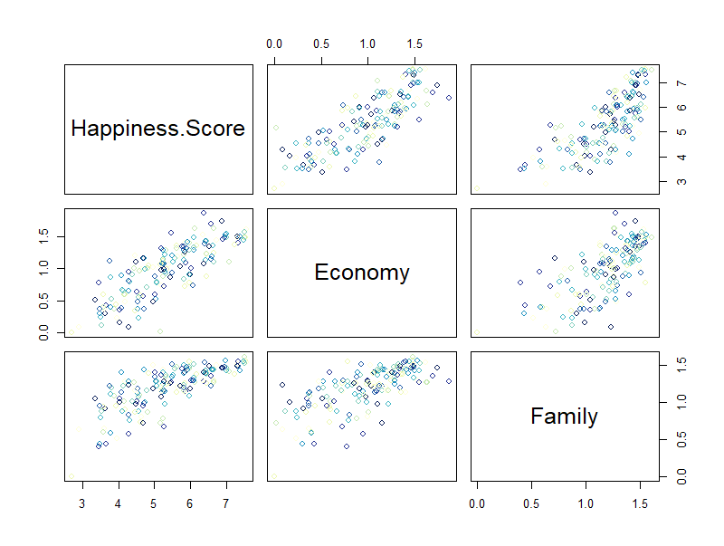
Multiple linear regression is a statistical method that models the linear relationship between one dependent variable and two or more independent variables.
The independent variables in our analysis are Economy, Life Expectancy, Family, Freedom, Generosity, and Trust.
The dependent variable is the Happiness score.
Five main assumptions underlying multiple regression models must be satisfied for our model to be accurate
1. Linearity
MULTIPLE LINEAR REGRESSSION

Slide 13
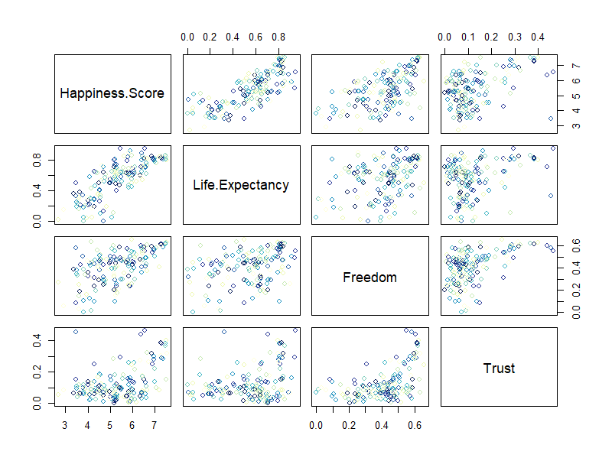
Multiple linear regression is a statistical method that models the linear relationship between one dependent variable and two or more independent variables.
The independent variables in our analysis are Economy, Life Expectancy, Family, Freedom, Generosity, and Trust.
The dependent variable is the Happiness score.
Five main assumptions underlying multiple regression models must be satisfied for our model to be accurate
1. Linearity
MULTIPLE LINEAR REGRESSSION

Slide 14
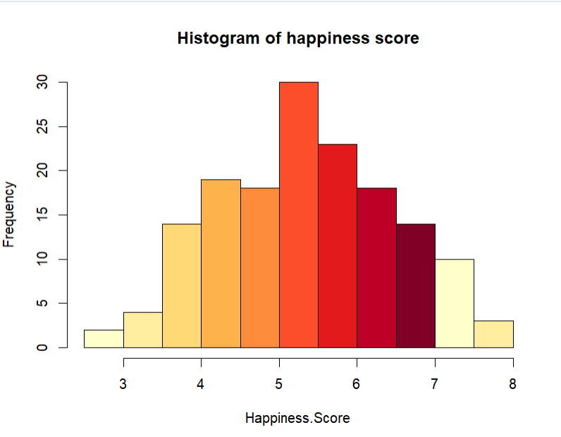
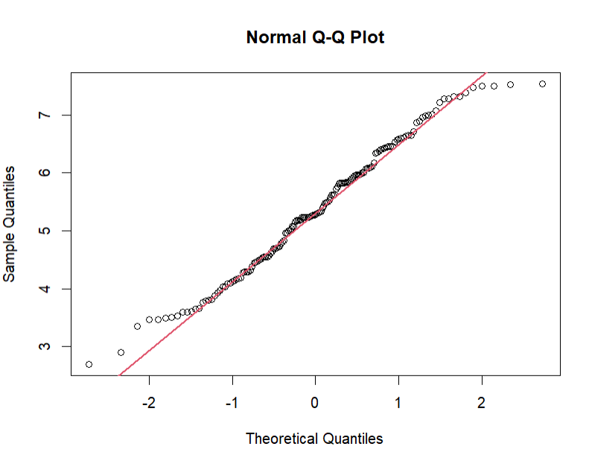
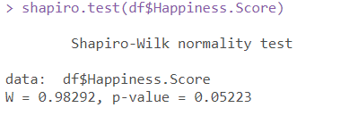
Multiple linear regression is a statistical method that models the linear relationship between one dependent variable and two or more independent variables.
The independent variables in our analysis are Economy, Life Expectancy, Family, Freedom, Generosity, and Trust.
The dependent variable is the Happiness score.
MULTIPLE LINEAR REGRESSSION
Five main assumptions underlying multiple regression models must be satisfied for our model to be accurate
2. Normality

Slide 15
Multiple linear regression is a statistical method that models the linear relationship between one dependent variable and two or more independent variables.
The independent variables in our analysis are Economy, Life Expectancy, Family, Freedom, Generosity, and Trust.
The dependent variable is the Happiness score.
MULTIPLE LINEAR REGRESSSION
Five main assumptions underlying multiple regression models must be satisfied for our model to be accurate
2. Normality

Slide 16
Multiple linear regression is a statistical method that models the linear relationship between one dependent variable and two or more independent variables.
The independent variables in our analysis are Economy, Life Expectancy, Family, Freedom, Generosity, and Trust.
The dependent variable is the Happiness score.
MULTIPLE LINEAR REGRESSSION
Five main assumptions underlying multiple regression models must be satisfied for our model to be accurate
2. Normality

Slide 17
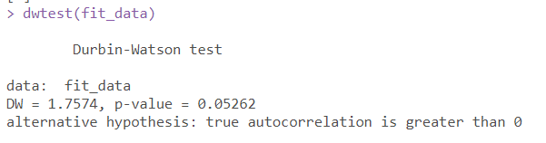
Multiple linear regression is a statistical method that models the linear relationship between one dependent variable and two or more independent variables.
The independent variables in our analysis are Economy, Life Expectancy, Family, Freedom, Generosity, and Trust.
The dependent variable is the Happiness score.
Five main assumptions underlying multiple regression models must be satisfied for our model to be accurate
2. Normality
MULTIPLE LINEAR REGRESSSION
Five main assumptions underlying multiple regression models must be satisfied for our model to be accurate
3. Autocorrelation
Durbin-Watson Test
As p>0.05, we can conclude that there is no evidence of autocorrelation

Slide 18
Multiple linear regression is a statistical method that models the linear relationship between one dependent variable and two or more independent variables.
The independent variables in our analysis are Economy, Life Expectancy, Family, Freedom, Generosity, and Trust.
The dependent variable is the Happiness score.
Five main assumptions underlying multiple regression models must be satisfied for our model to be accurate
2. Normality
MULTIPLE LINEAR REGRESSSION
Five main assumptions underlying multiple regression models must be satisfied for our model to be accurate
3. Autocorrelation
Durbin-Watson Test
As p>0.05, we can conclude that there is no evidence of autocorrelation

Slide 19
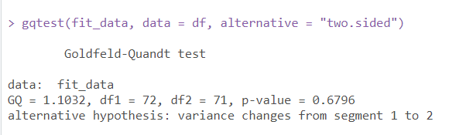
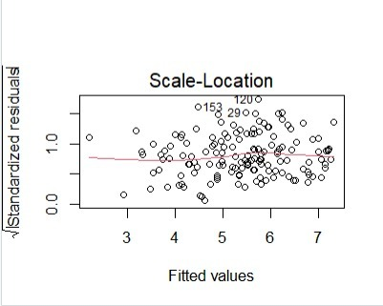
Multiple linear regression is a statistical method that models the linear relationship between one dependent variable and two or more independent variables.
The independent variables in our analysis are Economy, Life Expectancy, Family, Freedom, Generosity, and Trust.
The dependent variable is the Happiness score.
Five main assumptions underlying multiple regression models must be satisfied for our model to be accurate
2. Normality
MULTIPLE LINEAR REGRESSSION
Five main assumptions underlying multiple regression models must be satisfied for our model to be accurate
4. Homoskedasticity
Goldfeld-Quandt test
As p>0.05, we can conclude that there is no evidence of heteroskedasticity

Slide 20
Multiple linear regression is a statistical method that models the linear relationship between one dependent variable and two or more independent variables.
The independent variables in our analysis are Economy, Life Expectancy, Family, Freedom, Generosity, and Trust.
The dependent variable is the Happiness score.
Five main assumptions underlying multiple regression models must be satisfied for our model to be accurate
2. Normality
MULTIPLE LINEAR REGRESSSION
Five main assumptions underlying multiple regression models must be satisfied for our model to be accurate
4. Homoskedasticity
Goldfeld-Quandt test
As p>0.05, we can conclude that there is no evidence of heteroskedasticity

Slide 21
Goldfeld-Quandt test
As p>0.05, we can conclude that there is no evidence of heteroskedasticity
Multiple linear regression is a statistical method that models the linear relationship between one dependent variable and two or more independent variables.
The independent variables in our analysis are Economy, Life Expectancy, Family, Freedom, Generosity, and Trust.
The dependent variable is the Happiness score.
Five main assumptions underlying multiple regression models must be satisfied for our model to be accurate
2. Normality
MULTIPLE LINEAR REGRESSSION
Five main assumptions underlying multiple regression models must be satisfied for our model to be accurate
4. Homoskedasticity

Slide 22
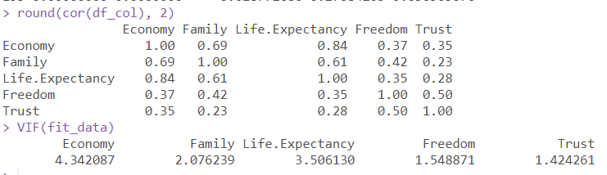
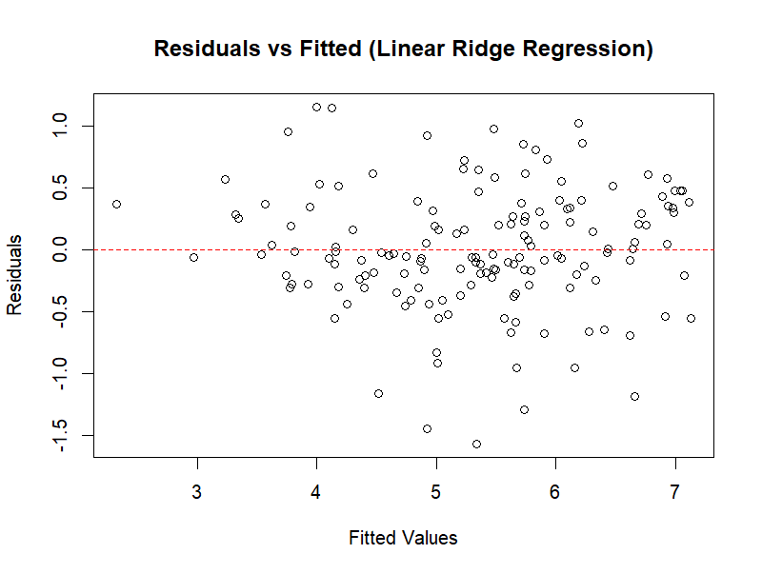
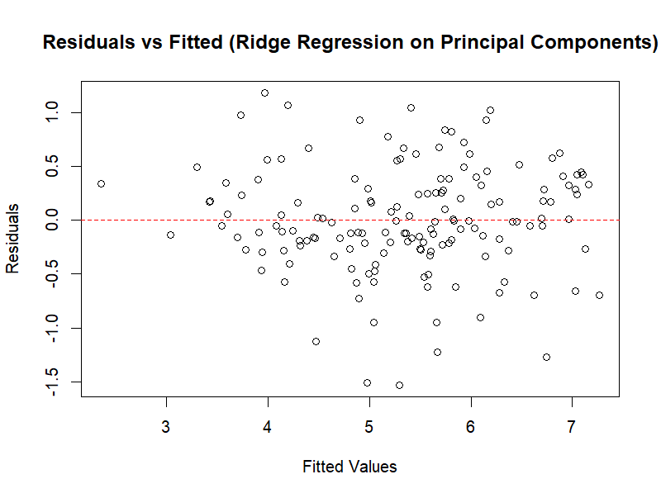
Multiple linear regression is a statistical method that models the linear relationship between one dependent variable and two or more independent variables.
The independent variables in our analysis are Economy, Life Expectancy, Family, Freedom, Generosity, and Trust.
The dependent variable is the Happiness score.
Five main assumptions underlying multiple regression models must be satisfied for our model to be accurate
2. Normality
MULTIPLE LINEAR REGRESSSION
Five main assumptions underlying multiple regression models must be satisfied for our model to be accurate
5. Multicollinearity

Slide 23
Multiple linear regression is a statistical method that models the linear relationship between one dependent variable and two or more independent variables.
The independent variables in our analysis are Economy, Life Expectancy, Family, Freedom, Generosity, and Trust.
The dependent variable is the Happiness score.
Five main assumptions underlying multiple regression models must be satisfied for our model to be accurate
2. Normality
MULTIPLE LINEAR REGRESSSION
Five main assumptions underlying multiple regression models must be satisfied for our model to be accurate
5. Multicollinearity

Slide 24
Multiple linear regression is a statistical method that models the linear relationship between one dependent variable and two or more independent variables.
The independent variables in our analysis are Economy, Life Expectancy, Family, Freedom, Generosity, and Trust.
The dependent variable is the Happiness score.
Five main assumptions underlying multiple regression models must be satisfied for our model to be accurate
2. Normality
MULTIPLE LINEAR REGRESSSION
Five main assumptions underlying multiple regression models must be satisfied for our model to be accurate
5. Multicollinearity

Slide 25
Multiple linear regression is a statistical method that models the linear relationship between one dependent variable and two or more independent variables.
The independent variables in our analysis are Economy, Life Expectancy, Family, Freedom, Generosity, and Trust.
The dependent variable is the Happiness score.
Five main assumptions underlying multiple regression models must be satisfied for our model to be accurate
2. Normality
MULTIPLE LINEAR REGRESSSION
Five main assumptions underlying multiple regression models must be satisfied for our model to be accurate
5. Multicollinearity

Slide 26
Mean Squared errors
 | MULTIPLE LINEAR REGRESSION | LINEAR RIDGE REGRESSION | LINEAR RIDGE REGRESSION ON PCA COMPONENTS
MSE | 0.2503319 | 0.2406834 | 0.2435668

Slide 27

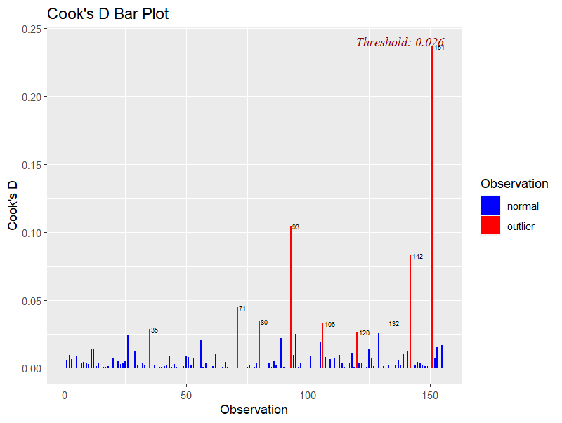
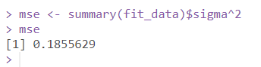
INFLUENTIAL POINTS
We remove the influential data points from the dataset and perform Multiple Linear Regression Again.
We find that the mean squared error has reduced

Slide 28

Predicting happiness scores of 2018
 | LINEAR REGRESSION | RIDGE REGRESSION
MSE | 0.7834322 | 0.2695662
India (4.19) | 4.712475 | 4.753671

Slide 29

THANK YOU
DONE BY:
ANITA DASH – MA20BTECH11001
AMULYA TALLAMRAJU – AI20BTECH11003

